Slide 1
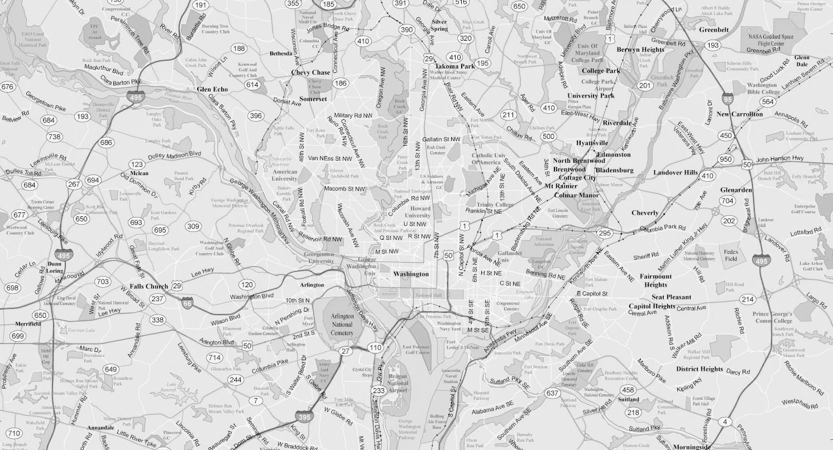
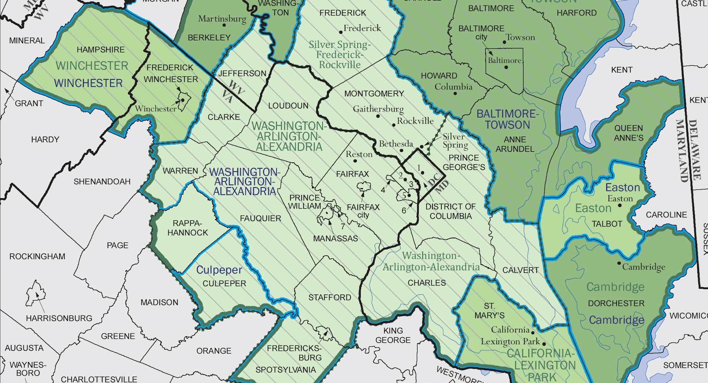

Analysis of 2000-2010 Air
Quality Trends in DMV Area
February 29, 2020
Dataset: New Pollution (Level 5)
Team: DC20052
Team Members: Nina Wang, Wanyun Yang, Bojing Fan
Mentor: Jennifer Chaffee

Slide 2
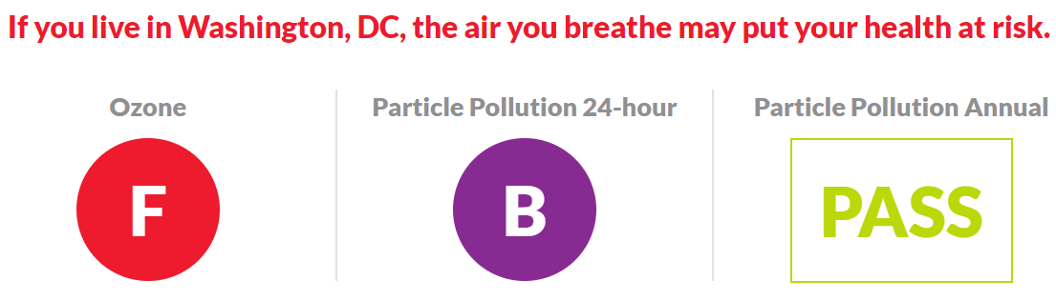
Source: Picture from American Lung Association https://www.lung.org/our-initiatives/healthy-air/sota/city-rankings/states/district-of-columbia/district-of-columbia.html

Slide 3
Dataset Overview

Slide 4
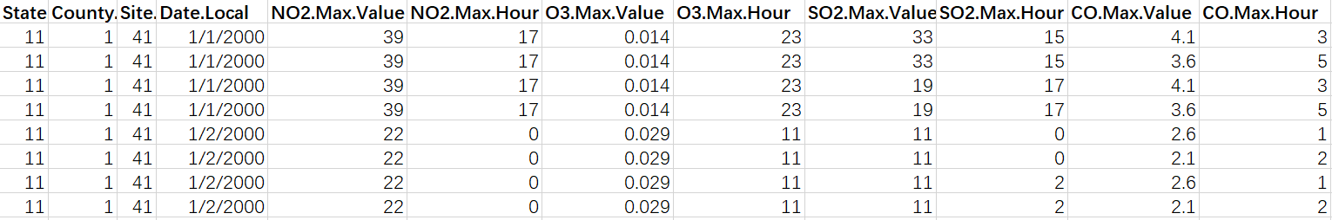
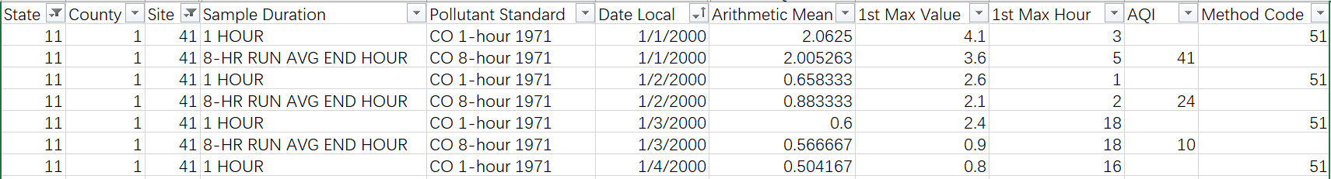
Dataset Overview
The provided dataset contained 43,894 rows, spanning from 1/1/2000 to 12/31/2010.
Notes:
SO2 1-hour 3-hour
NO2 1-hour
O3 8-hour

Slide 5
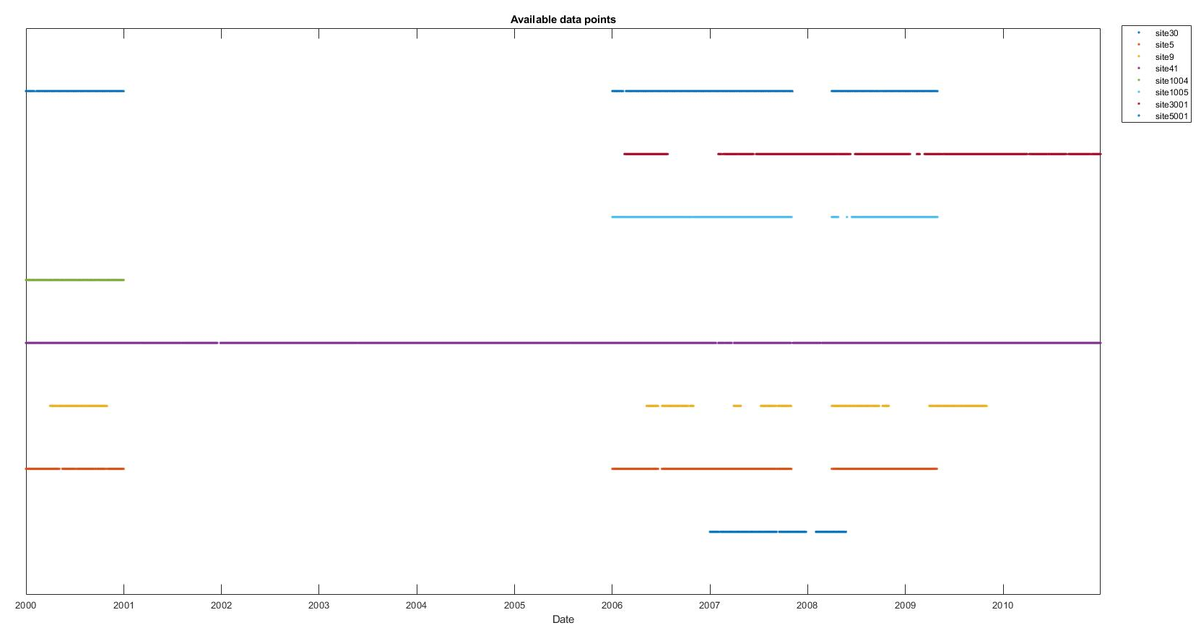
Dataset Overview: Empty time

Slide 6
Dataset Overview: Data collection
The collected dataset contained 16,320 rows, spanning from 1/1/2000 to 12/31/2010.
Additionally, daily average wind and precipitation data were retrieved from NOAA.
Only records with observations of all four pollutants were included, which left 10 sites in the area.
Notes:
Site 8 & 14 has a total of 134
National Oceanic and Atmospheric Administration

Slide 7
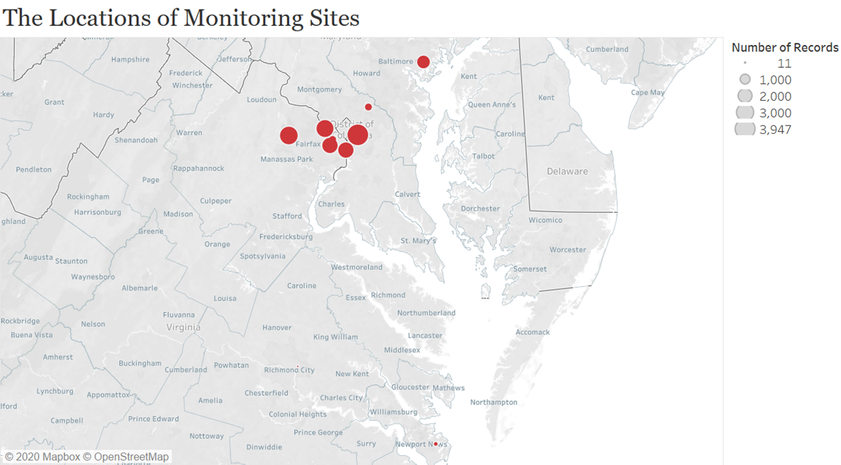
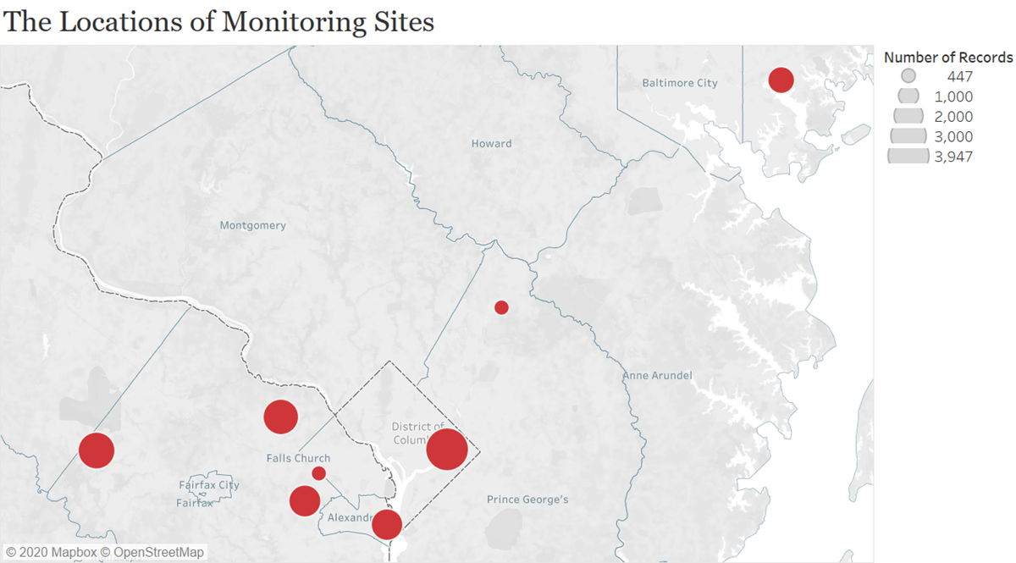
Dataset Overview: Collect raw data from EPA
Notes:
Site 8 & 14 has a total of 134
Majority is in DC metro
Baltimore only have data from 2005-2010

Slide 8
Time Series Analysis I

Slide 9
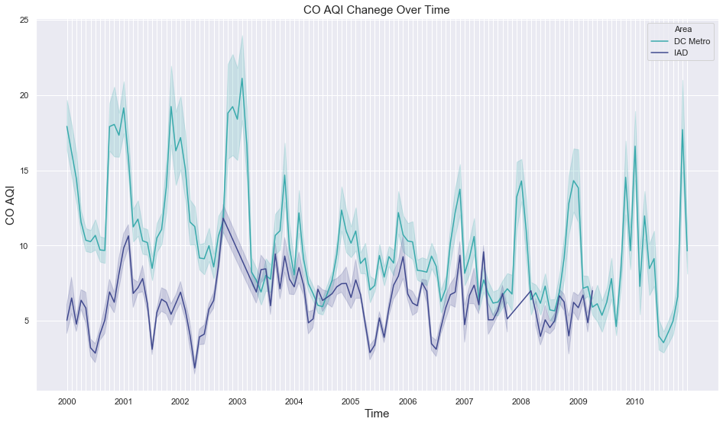

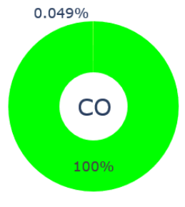
Carbon Monoxide
Notes:
This plot shows the monthly changes of Carbon Monoxide from 2000 to 2010. You can see two lines here, the green line represents DC metro area, the other one shows IAD area. Due to the very limited amount of Baltimore data, we decided not to show it here. We can see a noticeable drop in 2003.
The pie chart uses different colors to show the proportion of days with different air pollution qualities. Look at the legend, Green means good and purple means very unhealthy. Overall, only 0.049% of days we have moderate amount of CO in the DMV area, the rest days are all good.

Slide 10
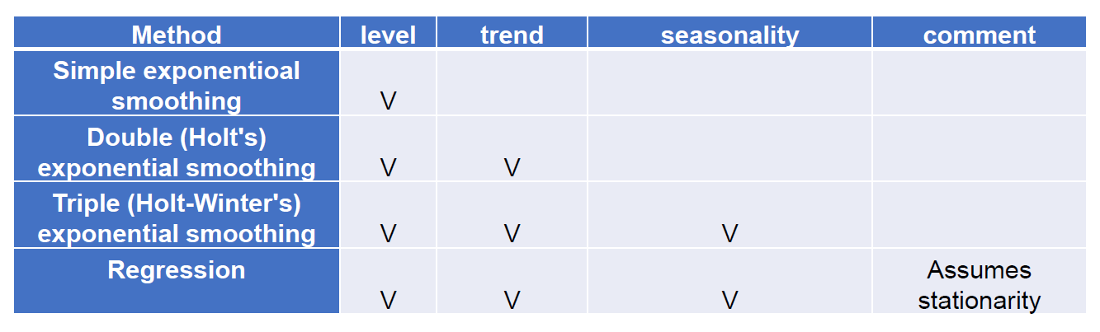
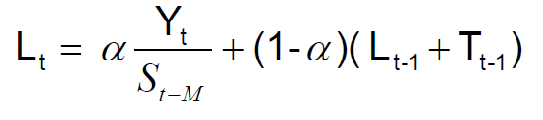
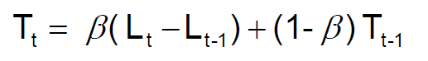
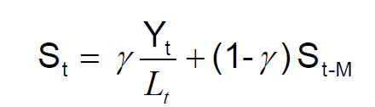
Since our data has obvious seasonality, we tried Winter’s Method:
𝐹𝑡+𝑛=𝐿𝑡+𝑛𝑇𝑡𝑆𝑡+𝑛
Notes:
Then we tried to do some time-series analysis here. From the previous line graph, we can see this data has level, trend, and seasonality. Therefore, we chose to use both Winter’s method and regression model. Lets talk about Winter’s method first.
This is a method basically predict the future data based on this formula. When we calculate the data at moment T+1, we need to use level, Trend and Seasonality from the moment T, and we also need to choose the best parameters of alpha, beta, and gamma that minimize the errors of prediction.

Slide 11
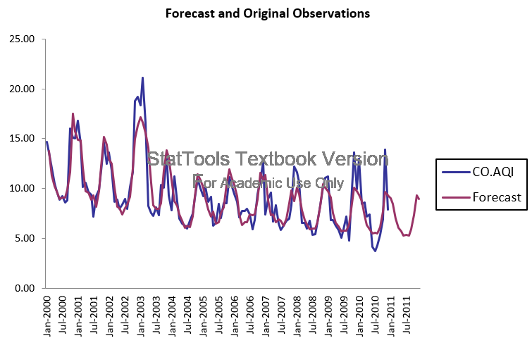
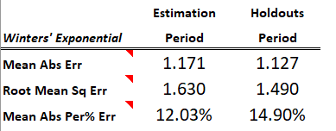
Notes:
For all these four types of pollutant, we divided the 11 years to 2 parts, 8 years for training and 3 years for validation. We also set the data of the next year as testing part. At the right upper corner, there is a table showing the error of our model over both training and validation periods.

Slide 12
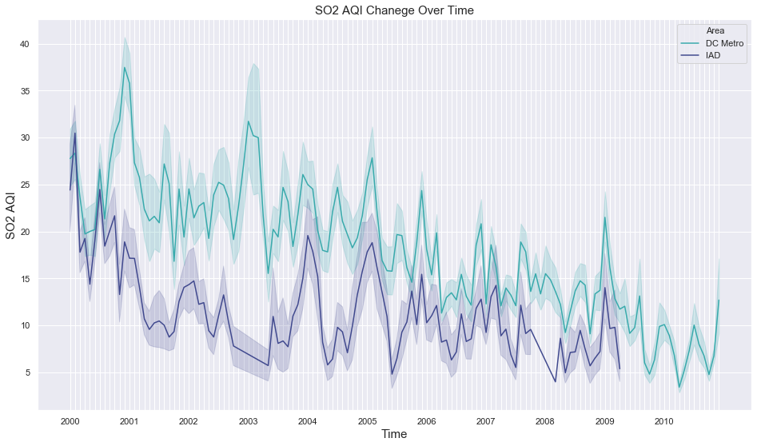
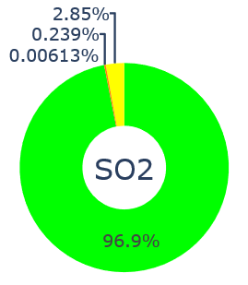
Sulfur Dioxide
Notes:
Then we did the same thing to Sulfur Dioxide.The amount of it keeps decreasing and we can see the overall situation is pretty good with 96.9% good condition days.

Slide 13
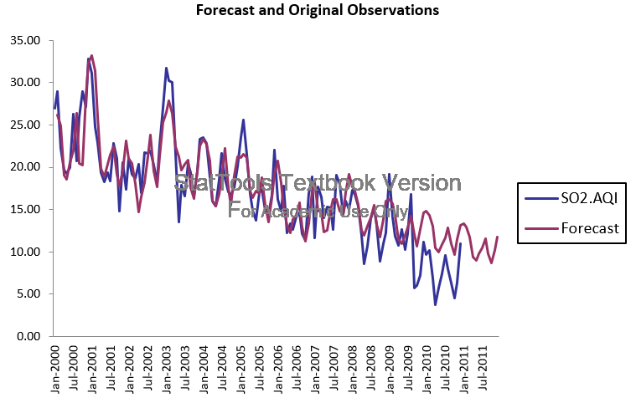
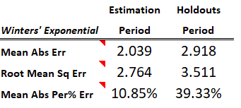
Notes:
This is the best result we can fit, but you can see this model does not fit as well as the one for CO.

Slide 14
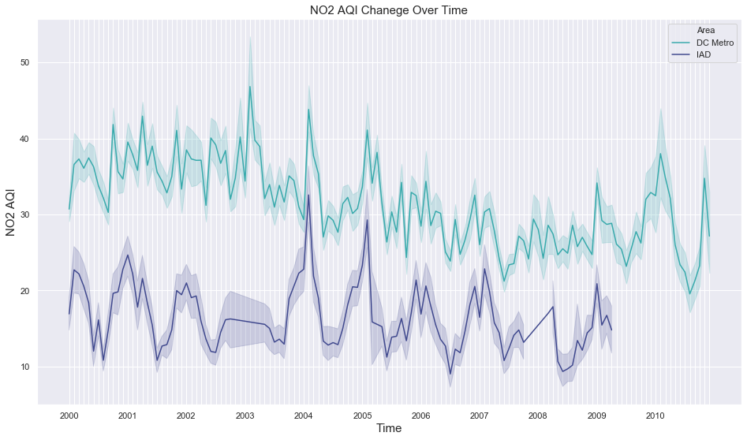
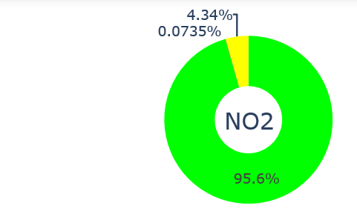
Nitrogen Dioxide
Notes:
For Nitrogen Dioxide, we can see a obvious gap between the two lines. This is reasonable because autos are a major source of NO2 emission and urban area has more cars. 95.6% of the pie charts are green, so it is good.

Slide 15
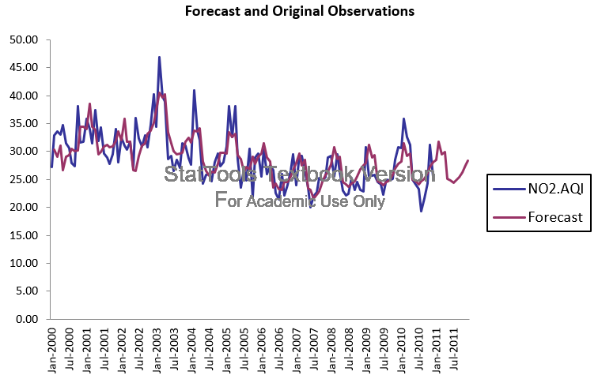
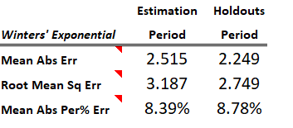
Notes:
We can see the errors we have here are very small, which implies we have a good predictive model.

Slide 16
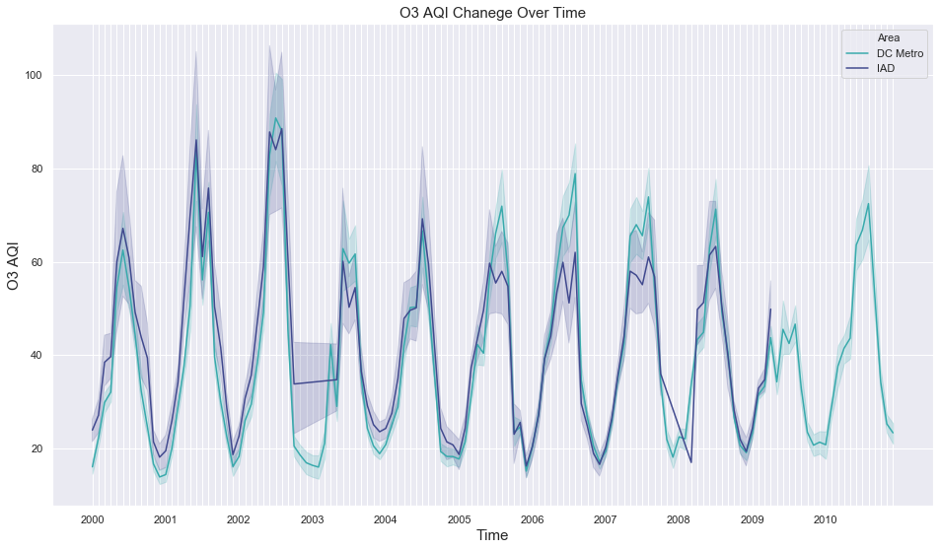
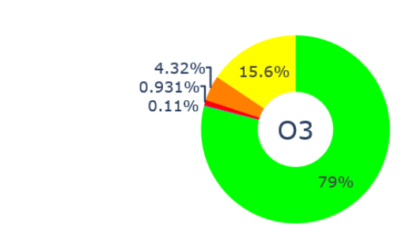
Ozone
Notes:
This one is for Ozone and the green line in the middle shows the cut off between good and moderate air pollution levels.
Ozone also had a drop in 2003.
Looking at the pie chart, we can tell O3 is the primary pollutant in the DMV area. 5.4% days are unhealthy for sensitive groups or worse.

Slide 17
Why?
2002/07/02
The Court held that the EPA illegally approved deficient clean air plans submitted by Virginia, Maryland, and the District. The plans failed to assure annual cuts in regional pollution as required by law.
2002/11/13
EPA reclassified the Metropolitan Washington area as a severe nonattainment area.
Notes:
Why was there a drop? Why was 2003?
We did some research. In the summer of 2002, The Court held that the EPA illegally approved deficient clean air plans submitted by Virginia, Maryland, and the District. The plans failed to assure annual cuts in regional pollution as required by law.
In the end of the year, EPA reclassified the DC area as a severe nonattainment area.
Then they added more regulations over OZONE.

Slide 18
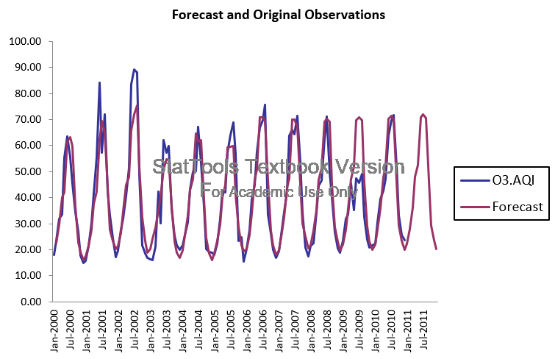
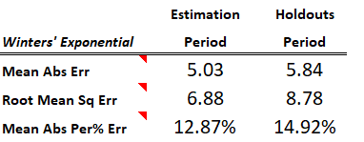
Notes:
This is the Winter model for Ozone. Winter is doing a better job on prediction than regression models, but it cannot help us analyze the factors and their effect on the pollution level. So, Bojing will talk more about it.

Slide 19
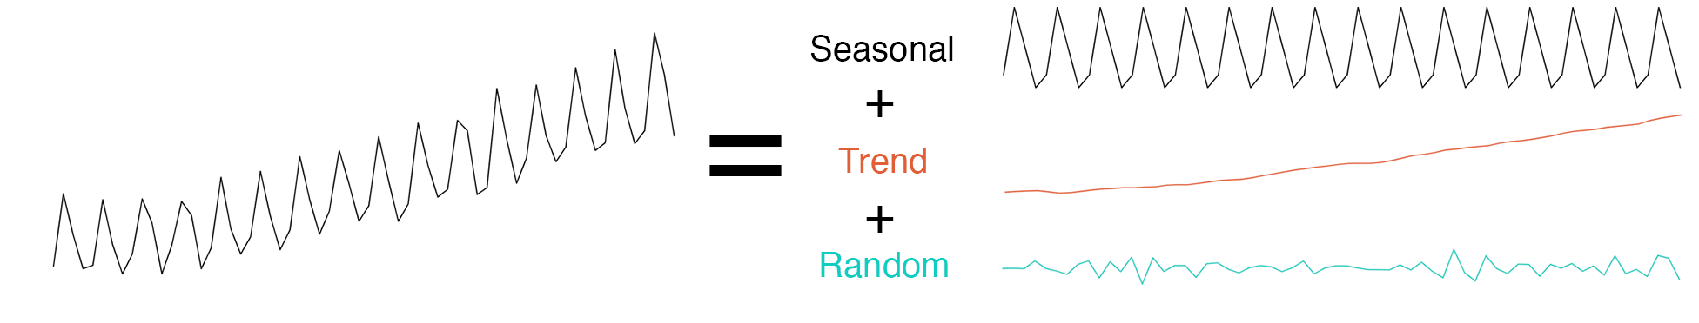
Time Series Analysis II

Slide 20
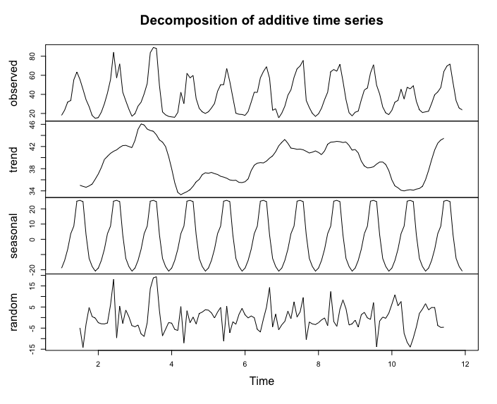

Slide 21
Model outcomes
Semi-log model of Ozone (Adj R²:0.3795)
Significant factors | Interpretation
State.Code | VA (3.45941) > MD (1.49926)> DC
Season | Summer > Spring > Autumn > Winter
Daytimes | Morning > Afternoon > Evening > Night
CO | Positive Correlation (0.26661)
NO2 | Positive Correlation (0.27092)
SO2 | Positive Correlation (0.06627)
Wind Speed | Negative Correlation (-0.09780)

Slide 22
Suggestion for Reducing Ozone Emission
NOx ❌ + Sunlight ❌ + VOC ✅
Ozone
Reduce VOC (Volatile Organic Compounds)
Notes:
On July 16, 2019, EPA approved the redesignation of the District of Columbia from marginal nonattainment to attainment for the 2008 NAAQS for ozone
Ozone is secondary pollutant

Slide 23
Implements
Avoid using aerosol consumer products such as hairsprays, air fresheners, deodorants, and insecticides that often use VOCs as their propellants.
Avoid using VOC-containing products such as organic cleaning solvents.
Store VOC-containing products in air-tight containers.
Buy products with less packaging as the printing of packaging materials generates VOCs.
Drive less, share rides and use public transportation.
Source: EPA(2011). Volatile Organic Compound (VOC) Control Regulations. https://www3.epa.gov/region1/airquality/voc.html
Notes:
According to a study from EPA, 51% of VOC is from mobile. So one way to reduce VOC is to encourage citizens to use more public transportation.
In our case, DC area has one of the most advanced metro system in the state. The government should keep working on it, the metro system so that more
And more people are not only willing, but enjoy taking public transportation. One thing should always be kept in mind that meeting the health-based air quality standards is one of the administration’s top priorities because all human beings have the right to breathe clean air

Slide 24
Thank you!

